Slide 1
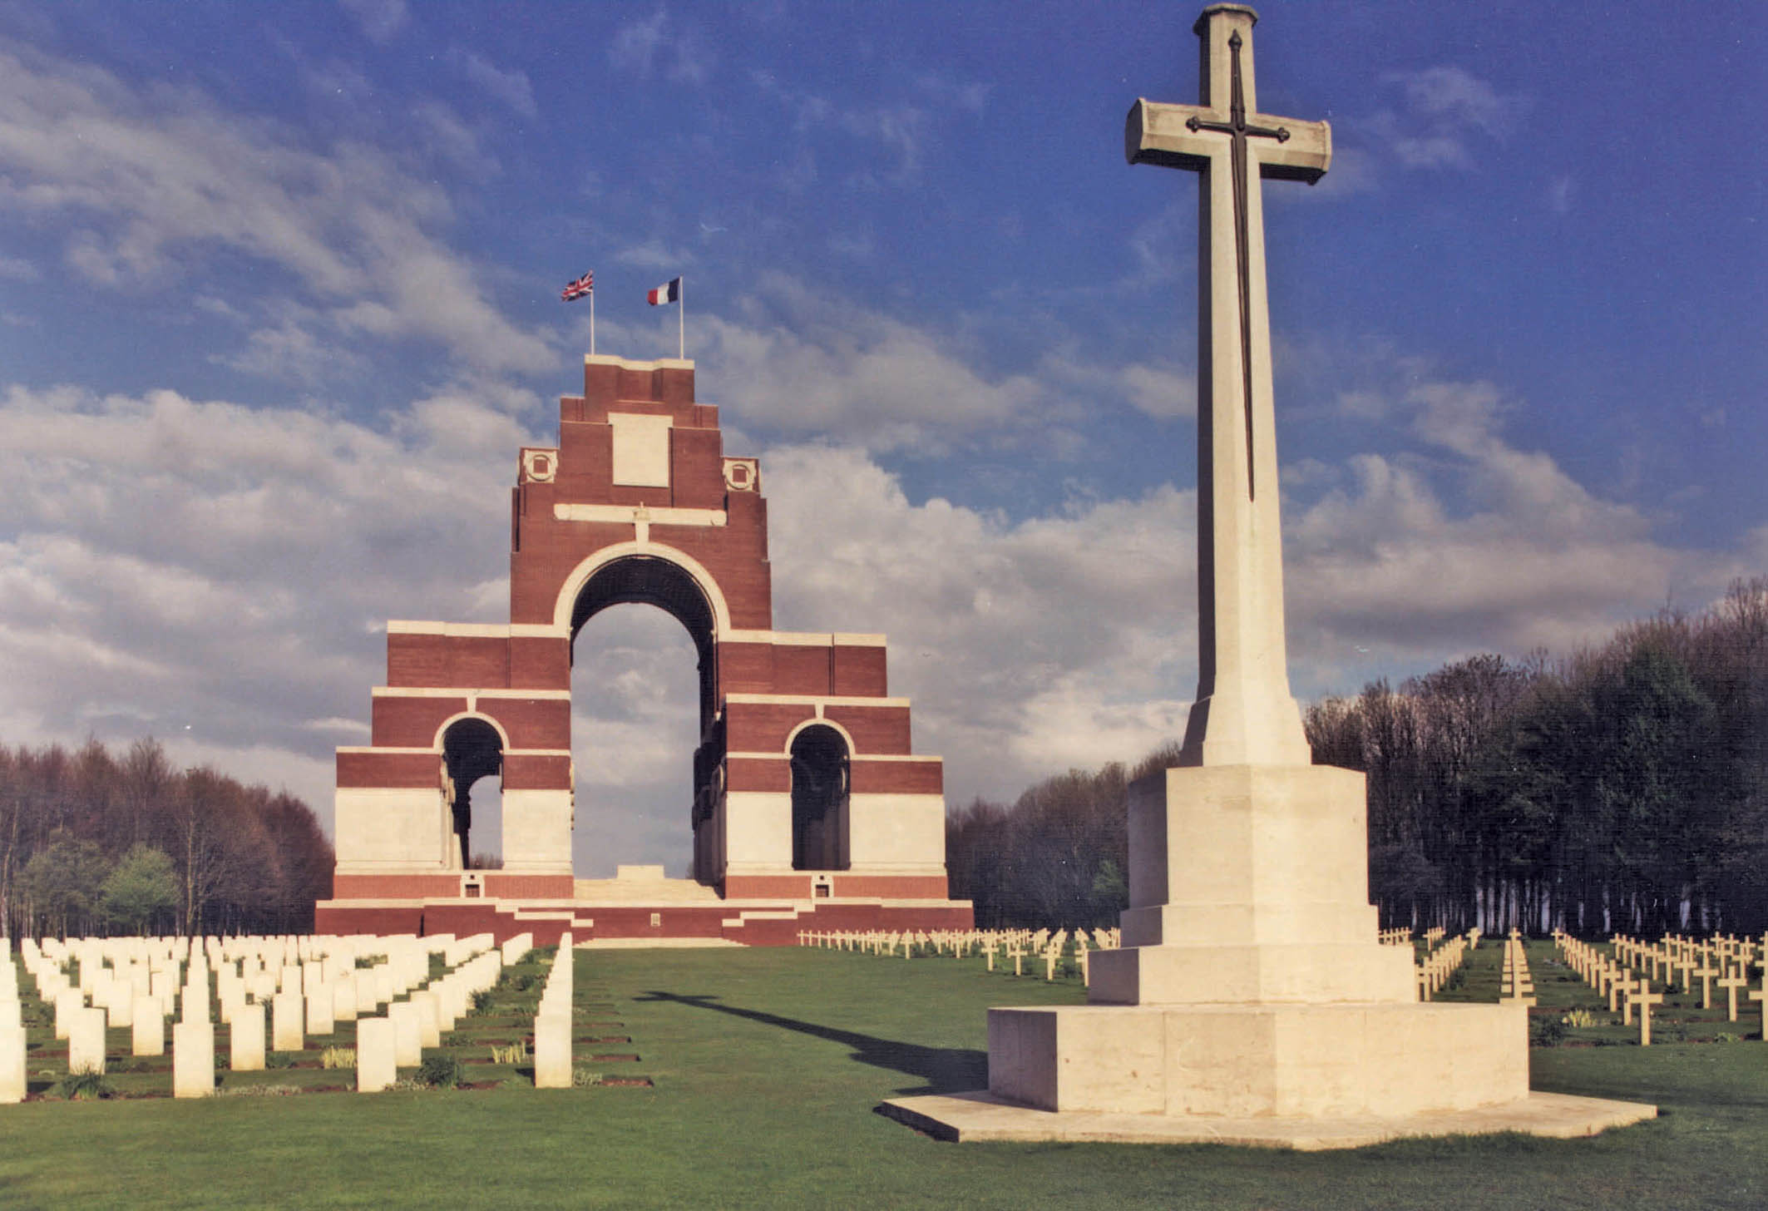
Battlefields Trip
2015

Slide 2

STAFF
Mrs Bulmer – Trip Leader
Mrs Kernohan – Trip Leader
Mr Barrott
Miss Poppleton
Miss Sunderland

Slide 3
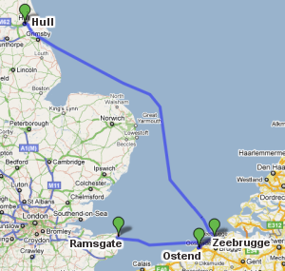


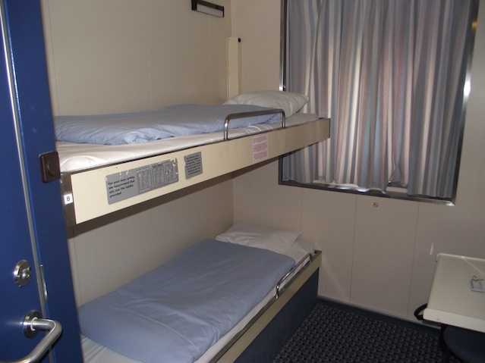
ITINERARY
DAY 1
Tuesday 28TH April
Pupils in lesson until 2:30pm
Depart from school at 3pm and travel to Hull
6:30 pm P &O Ferry to Zeebrugge over night crossing
Dinner, breakfast and packed lunches provided
Pupils accommodated in 4 berth cabins

Slide 4
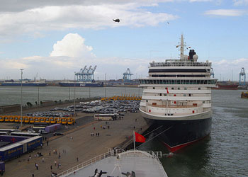
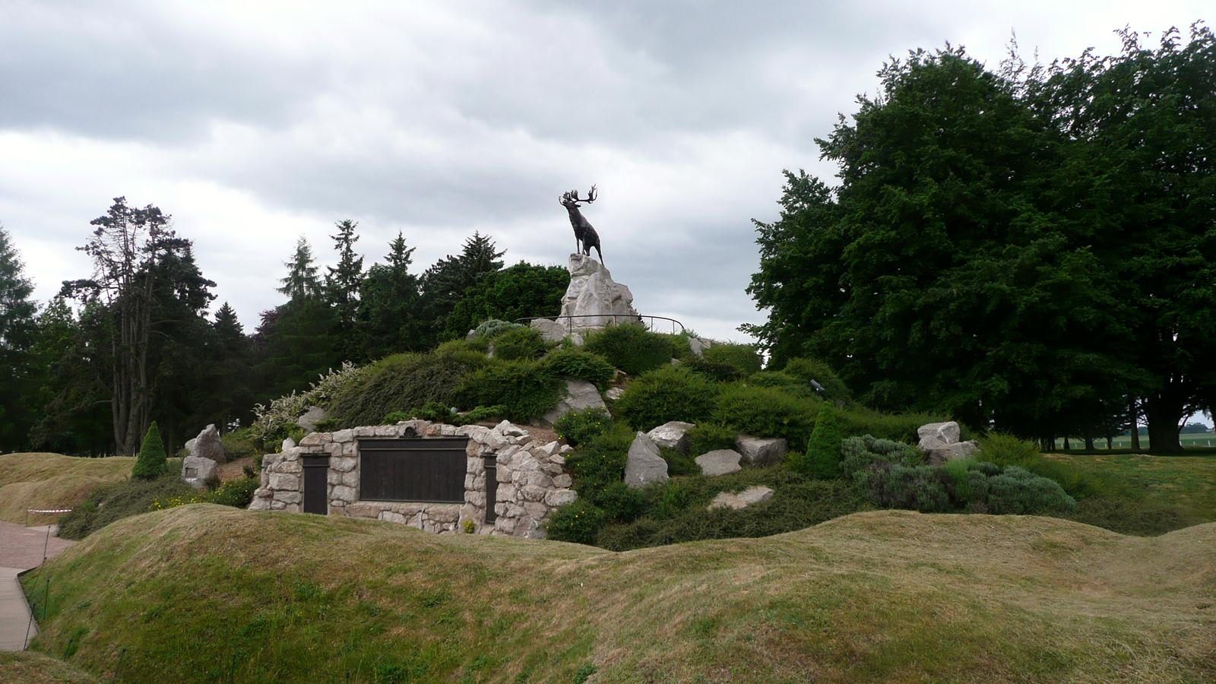
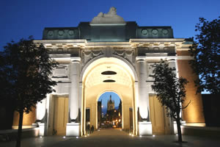
ITINERARY
DAY 2
Wednesday 29TH April
Arrive Zebrugge 8:45 am
Coach to the Somme
Tour of the important sites of this battle
Late Afternoon travel to Ypres in Belgium in time for Menin Gate ceremony at 8pm
Accommodation at Peace Village with evening meal

Slide 5
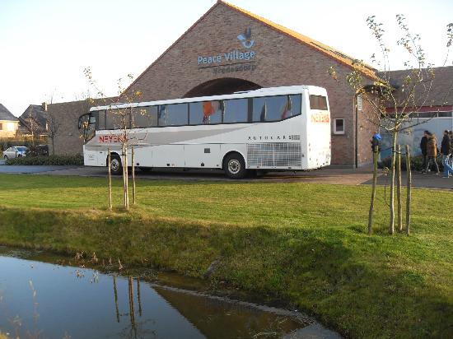
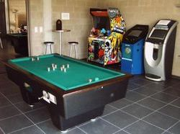
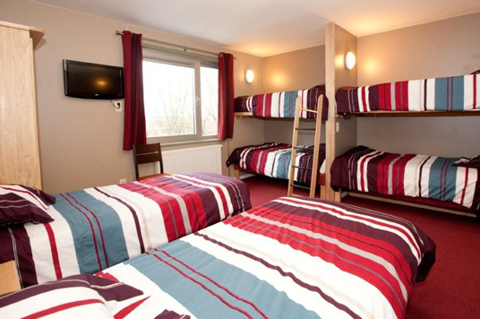
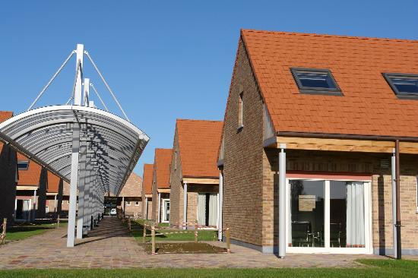
Peace Village
Ypres
Peace Village
Nieuwkerkestraat 9 A, Ieper (Ypres) B-8957, Belgium
A beautiful new build in 'No Man's Land'. The rooms are huge with mezzanine floor bedrooms. Downstairs there are wet rooms with separate loo, sitting area and work space for a laptop etc. great patio doors open onto a grassed area outside each of the rooms.

Slide 6
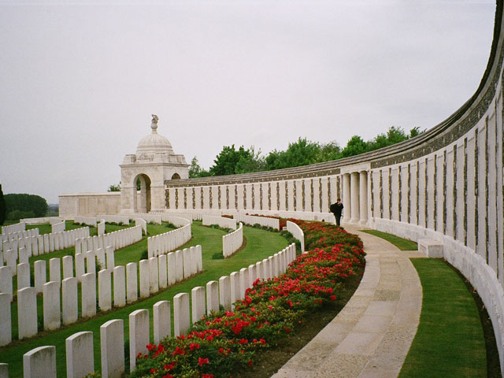
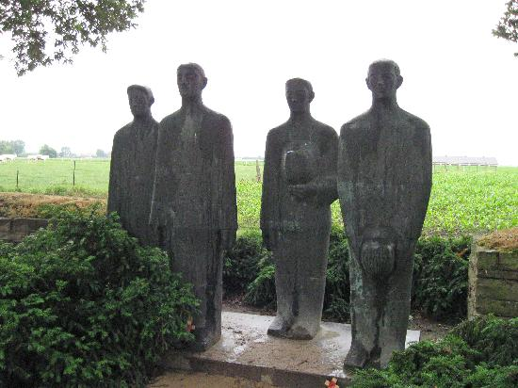
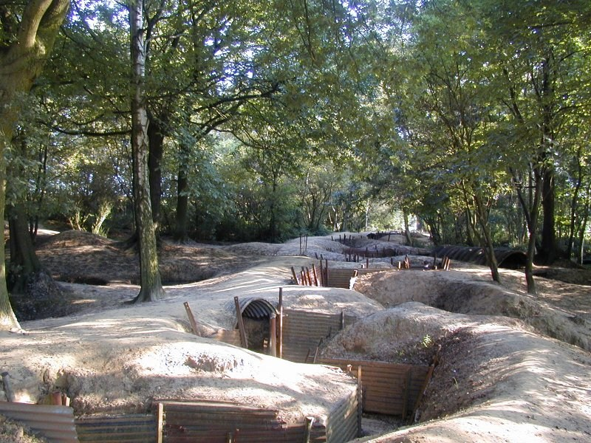
ITINERARY
DAY 3
Thursday 30TH April
Breakfast at Peace Village
Tour of the Ypres Salient
Including Flanders Field Museum, Tyne Cot cemetery, Sanctuary Wood, Essex Farm and Langemark German Cemetery

Slide 7
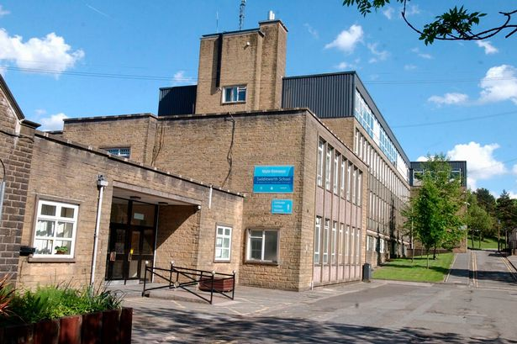
ITINERARY
DAY 4
Friday 1st MAY
8:45am Arrive Hull after breakfast on ferry
Travel back to school
Straight back to lessons…..

Slide 8
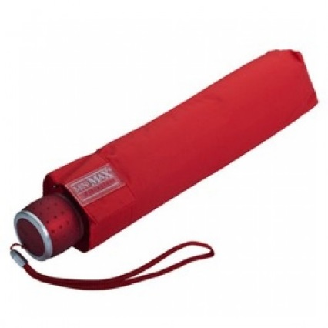
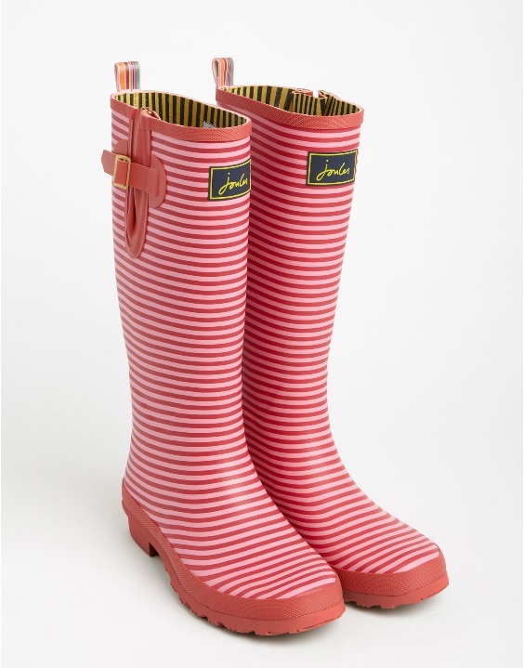
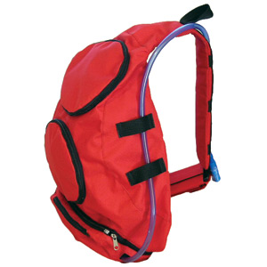
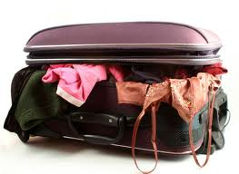
Packing
PLEASE PACK SUITABLE CLOTHING FOR ALL WEATHERS, IN PARTICULAR COAT, COMFORTABLE WATERPROOF FLAT FOOTWEAR AND LAYERS AS WEATHER CAN BE VERY UNPREDICTABLE. PLEASE ALSO BRING A SMALL BACK PACK
PLEASE PACK A COUPLE OF TOWELS
PLEASE DO NOT PACK HAIR STRAIGHTNERS
PLEASE KEEP VALUABLES TO A MINIMUM

Slide 9
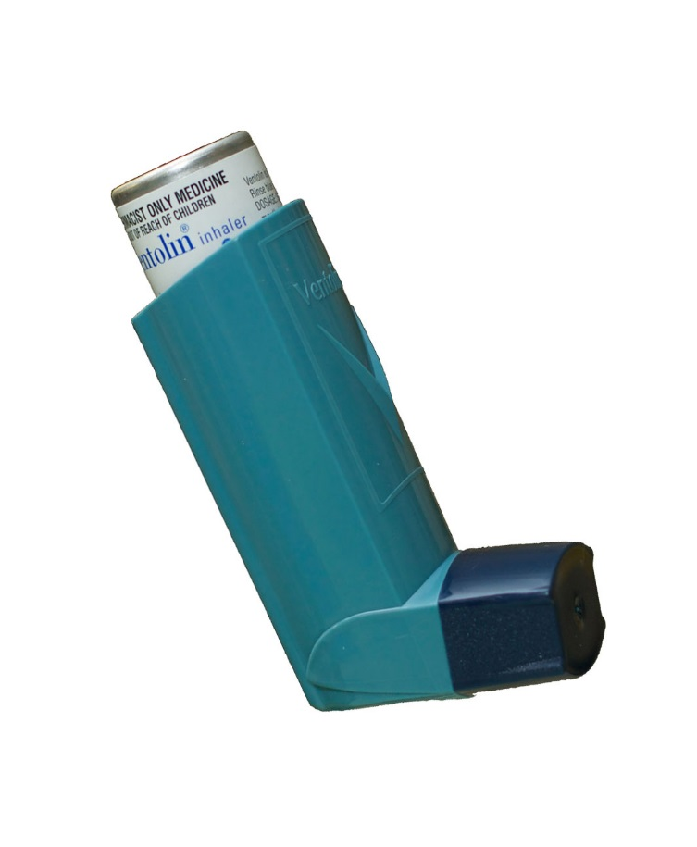

PLEASE LET US KNOW IF YOUR CHILD IS ON ANY MEDICATION THAT THE SCHOOL IS NOT ALREADY AWARE OF.
YOU WILL APPRECIATE THAT YOUR CHILD IS RESPONSIBLE FOR THEIR OWN MEDICATION.
WE WILL NOT BE ABLE TO PROVIDE ANY MEDICATION FOR YOUR CHILD ON THE TRIP HOWEVER IF YOU HAVE ANY CONCERNS AT ALL PLEASE SPEAK TO US AT THE END
Medication

Slide 10
The Rules - Travel
NEVER wander off alone at any time
Give your passport to your allocated teacher for safe keeping
Wear seatbelts at all times
Absolutely perfect behaviour on coach and ship– sit down and stay seated
Follow all safety procedures on the ship
Do not litter

Slide 11
The Rules - Boat and Hotel
RESPECT other guests and all staff
NEVER leave your room after lights out
NEVER answer your door to a stranger – wait until the person identifies themselves
Keep your room tidy
Look after your belongings

Slide 12
The Rules - At all times….
Absolutely NO alcohol or smoking!!!!
No football strips
Listen and follow EVERY instruction
Be Punctual – always 5 minutes early!
ALWAYS carry your emergency info card and know your group and group leader

Slide 13
Emergency Contact Number
07825507638

Slide 14


