Slide 1
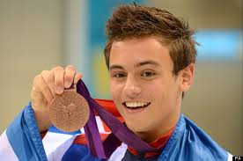
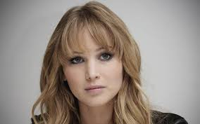
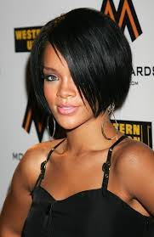
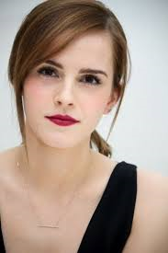
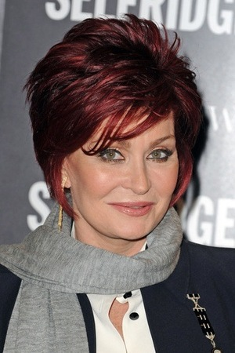
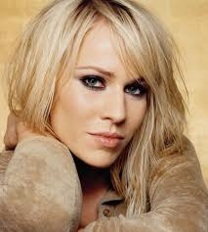
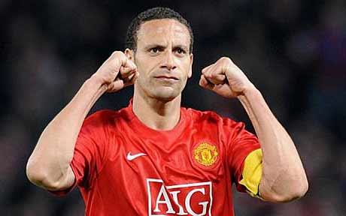
What do these people have in common?

Slide 2
https://www.youtube.com/watch?v=LIphRBFrfPs
They were all bullied at school.

Slide 3
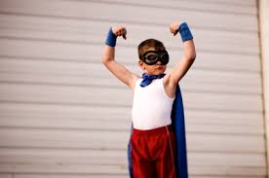
Bullying destroys confidence.

Slide 4
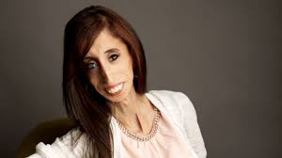
Lizzie Velasquez has a rare illness which means she has 0% body fat.
She was bullied throughout school because of the way she looked.
https://www.youtube.com/watch?v=dIr3mlNINmg

Slide 5
What should you do if you are worried about bullying?

Slide 6


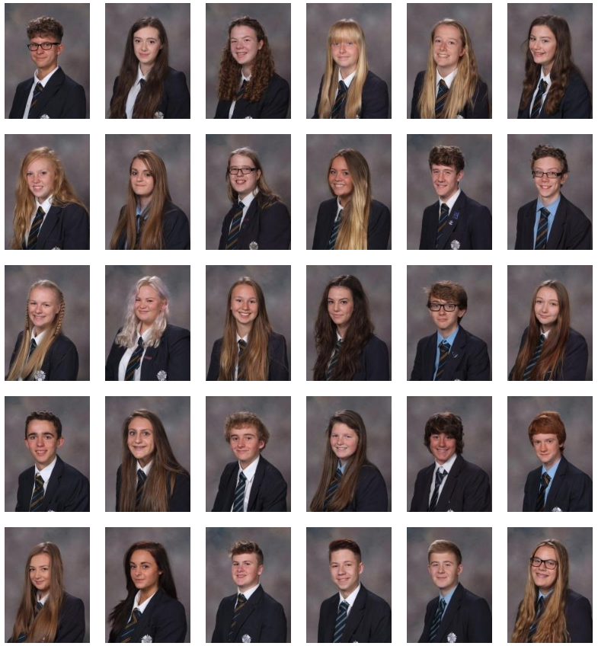
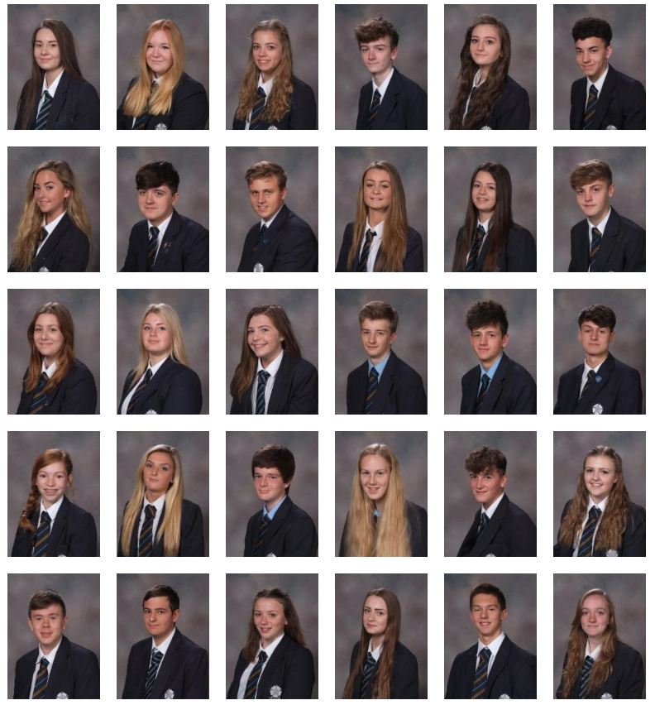
Saddleworth School takes bullying very seriously.
The red post box in reception is checked daily for any notes of concern.
All prefects have had anti-bullying training and can help you if you do not want to talk to a member of staff.
Your diary contains the school’s new Anti-bullying Policy.
Your form tutors will be going through this with you this week.

Slide 7
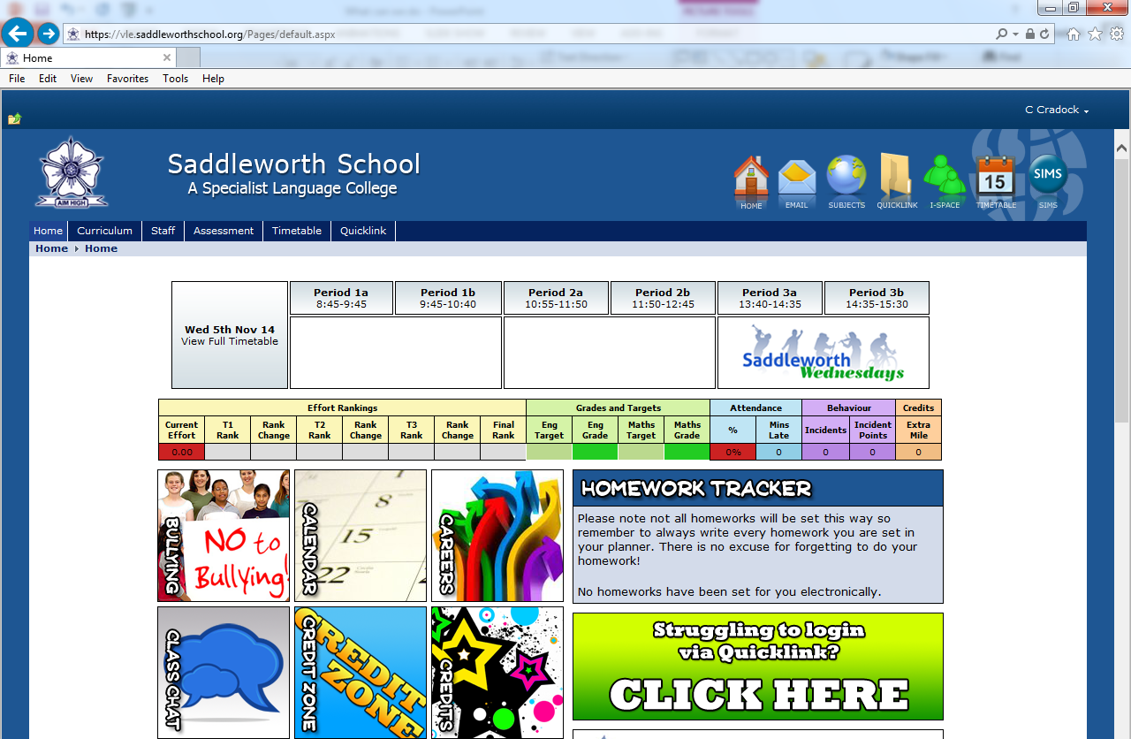
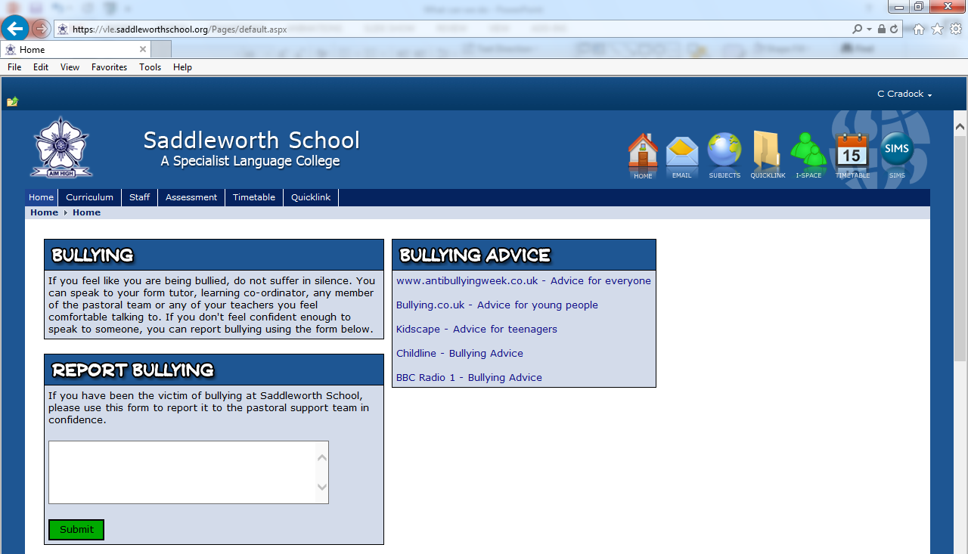
If you are concerned about bullying you can visit the school’s Anti-Bullying page for advice.
You can complete the Report Bullying form to log any of your concerns.
This is a confidential message which will only be passed on to your Head of Year, Pastoral Assistant and Mr Hall who will then help you.

Slide 8

Never suffer in silence.
Always tell someone if you, or someone you know is being bullied.
https://www.youtube.com/watch?v=Wc2JlNqU9GA&list=PL5C2556B95D7B718C

