Slide 1

Revision Guidance
Extended Form
Friday, 18th March 2016

Slide 2














This year for some of you will be one of the most stressful yet rewarding years of your life.
Organisation in the next 6 – 8 weeks will be the key to success.
The workload is high and prior planning and preparation will help spread the load.

Slide 3

Today, you will receive your examination timetable. It is really important that you check the tiers of entry and that all your
subjects are noted.
You must return the ‘parent/carer’ declaration by Thursday, 24th March. This form
is to be returned to RECEPTION.
Year 11
In addition, you will receive a ‘Guide to Examinations’
booklet.
Today 1

Slide 4

The best revision methods involve being active. So, don’t just sit there – DO SOMETHING!
Active revision means involving your eyes, ears and hands in a variety of ways. Revising actively is the best way to make sense of the material you’re revising and also helps you remember it.
Active methods of revision include: writing revision notes, reading notes aloud, recording key points onto your phone, discussing topics with a friend, testing yourself, getting others
to test you, rewriting notes,
doing examples, trying past
exam papers and using
revision apps and websites.
Year 11
Active Revision

Slide 5
Learning to learn
Effective learners are active learners

Slide 6
Just because you have memorised something and are now able to recall it without looking at your notes, that doesn’t mean that tomorrow or the next day, you will still be able to recall it.
Learning to learn
Effective learners are active learners

Slide 7
Research shows that you will need at least three sessions to commit information to memory, four being ideal.

Slide 8
80% of new information is lost in the first 24 hours. At this point, you will be revisiting information and there are a variety of methods that help you to revise.
Learning to learn
Effective learners are active learners

Slide 9
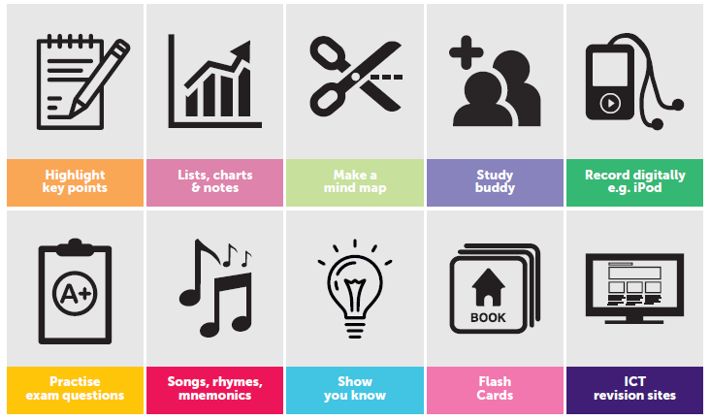
Year 11
How do I study?

Slide 10

We recommend revision every day in the eight weeks prior to exams, with more time spent over the weekend.
Little and often is best for memory work.
Try and work for no longer than 45 minutes at a time – then get up and do something else for 20 minutes.
Ensure that you include break times during the day, these are important to help you unwind and to make sure you don’t burn yourself out.
Make a note of all important
dates – assessments, exams,
sport commitments, etc.
Year 11
Time Management

Slide 11

Switch off or remove for a while things that will cause distractions. It may be that the iPhone or X-Box needs to be hidden!
Work out when you ‘study best’, for instance some people are able to concentrate better in the morning. Then use these times to study those topics that require the most effort
and energy.
Declutter your study space
so you can work comfortably
and concentrate.
Year 11
Distractions

Slide 12
There’s quite a lot of revision time available – if you manage it well!
There are many good reasons to use a revision timetable:
Year 11
To avoid a last-minute rush
To set up a routine
To share revision between subjects
To spread out your revision
To get the right balance between revision and leisure tome
To avoid wasting time
Be realistic – don’t overburden yourself.
Timetables

Slide 13
After completing a revision period cross it off from your timetable. This will help to instil a sense of accomplishment.
At the end of each week assess your performance and change your plans accordingly.
Keep your timetable flexible and be ready to change it if circumstances change.
There are 3 main reasons why timetables don’t work – too much detail, over-ambitious and unrealistic.
A timetable is not meant to tie you down in a rigid way but can be an excellent tool to help guide you through your revision period.
Year 11
Timetables

Slide 14
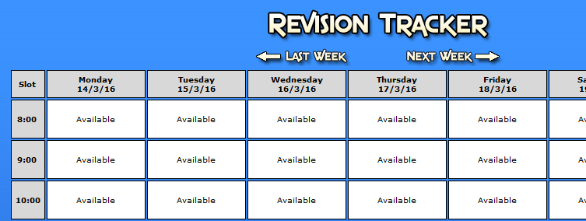
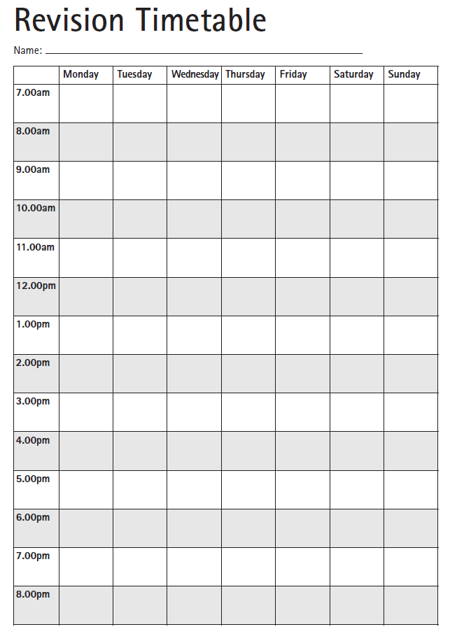
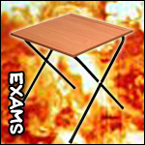
Year 11
Check out the revision tracker section on the VLE (look in the Exams section on your home page).
If you prefer a paper timetable,
this too can be located on the VLE.
Revision Timetable

Slide 15
Make a list of the subjects that you need to revise for between now and your exams.
Work out which subjects have the most content that needs to be revised.
Concentrate on those specific topics or modules that you are weak on
(understanding your progress information and data is vital in this regard).
Year 11
Subject Priorities

Slide 16

Break down major revision subjects into smaller parts, this can help you make your studying more precise.
Do not leave your most difficult or hardest subjects till the end of the day. Instead try to get these out of the way early on.
Try not to spend the whole day revising one subject.
Year 11
Subject Priorities

Slide 17

Staying motivated is really important – a good way to sat motivated is to set targets during revision and reward yourself when you hit your targets.
Plan your rewards – it could be a chunk of chocolate, listen to your favourite song, etc
Your first reward could be for completing your revision timetable.
Year 11
Motivation

Slide 18

The health benefits of exercise are strongly accepted in the medical community – it’s obvious it is good for your body, but it’s great for mental health. Exercise is prescribed for anxiety – could you maybe walk to school? Walking pushes oxygen around the body, takes you away from a screen and gives you thinking time.
Getting a good sleep will make a difference to how you feel – you’ll find it easier to produce good work after a good sleep – if you
don’t have enough sleep,
you will find it hard to focus!
Year 11
Look after yourself!

Slide 19
Avoid caffeine, a big meal, vigourous exercise, loud music, bright lights, arguments and screens AT LEAST one hour before you go to sleep!
To get you sleepy try a shower or bath before bed, soft music, reading for pleasure, a milky drink or lavender oil on your pillow.
Eat and drink well – drink plenty of water!
Year 11
Look after yourself!

Slide 20

Forget spiders, snakes and heights, our greatest fear is the fear of failure.
We fear not being good enough, not achieving our potential, letting those round us down and we fear being seen as a failure.
The fear of failure can have a negative impact on our performance. If we dwell on the consequences of under-achieving the thought of failure becomes more and more terrifying.
Imagine your brain is a computer and
you need to reprogram it, strip down
the negative beliefs and replace them
with a more productive way of thinking.
Year 11
Pressure

Slide 21

Use deep breathing to relax your body and mind.
Use positive language with yourself and visualise your exams going smoothly.
If possible, avoid classmates who are highly stressed or who want to talk about the exams.
Practise your relaxation techniques so they are natural to you by exam day.
Plan your exam day so you
feel in control; allow for
travel and proper meals.
Year 11
Pressure

Slide 22
When doing homework and revision, ensure that you are away from all distractions. If necessary, create a study space that you can use purely for school work in order to create boundaries between work and free time.
Don't underestimate the power of free time. Near exams, it seems that there are not enough hours in the day and throughout the year all work can feel like this. However, it is important to take time to relax. Don't give up on your hobbies and, if necessary, take a walk or listen to some music.
Year 11
Former Pupils Top Tips!

Slide 23
If you are struggling on any topic ASK FOR HELP NOW - otherwise you will regret it when you are revising for all your exams and have an extra thing to try and work out.
Keep your files and notes organised; GCSEs are still a while off, but you can give yourself one less stressful task at the time by keeping your file neat now. There's nothing worse than fishing through jumbled notes when revising!
Have revision parties (sounds really sad), but it worked for some former pupils. Order a pizza, put some music on, and have a revision party. You can help each other out, playing off each other's strengths, as the ability to teach your friends what you've been revising shows it's really going in.
Year 11
Former Pupils Top Tips!

Slide 24
Buy some coloured pens; coloured pens are great in revision. They ensure that the important stuff stands out on the page and, if you stick to a scheme, different colours can trigger bits of information.
Try not to freak out; no one revises well when they're stressed. It's better to take a two hour break to chill out, and then restart the work, than cramming information into a foggy mind.
Attend extra sessions, Easter sessions. Take advantage of all the help available! Don’t attend sessions just because your friends are going.
Year 11
Former Pupils Top Tips!

Slide 25
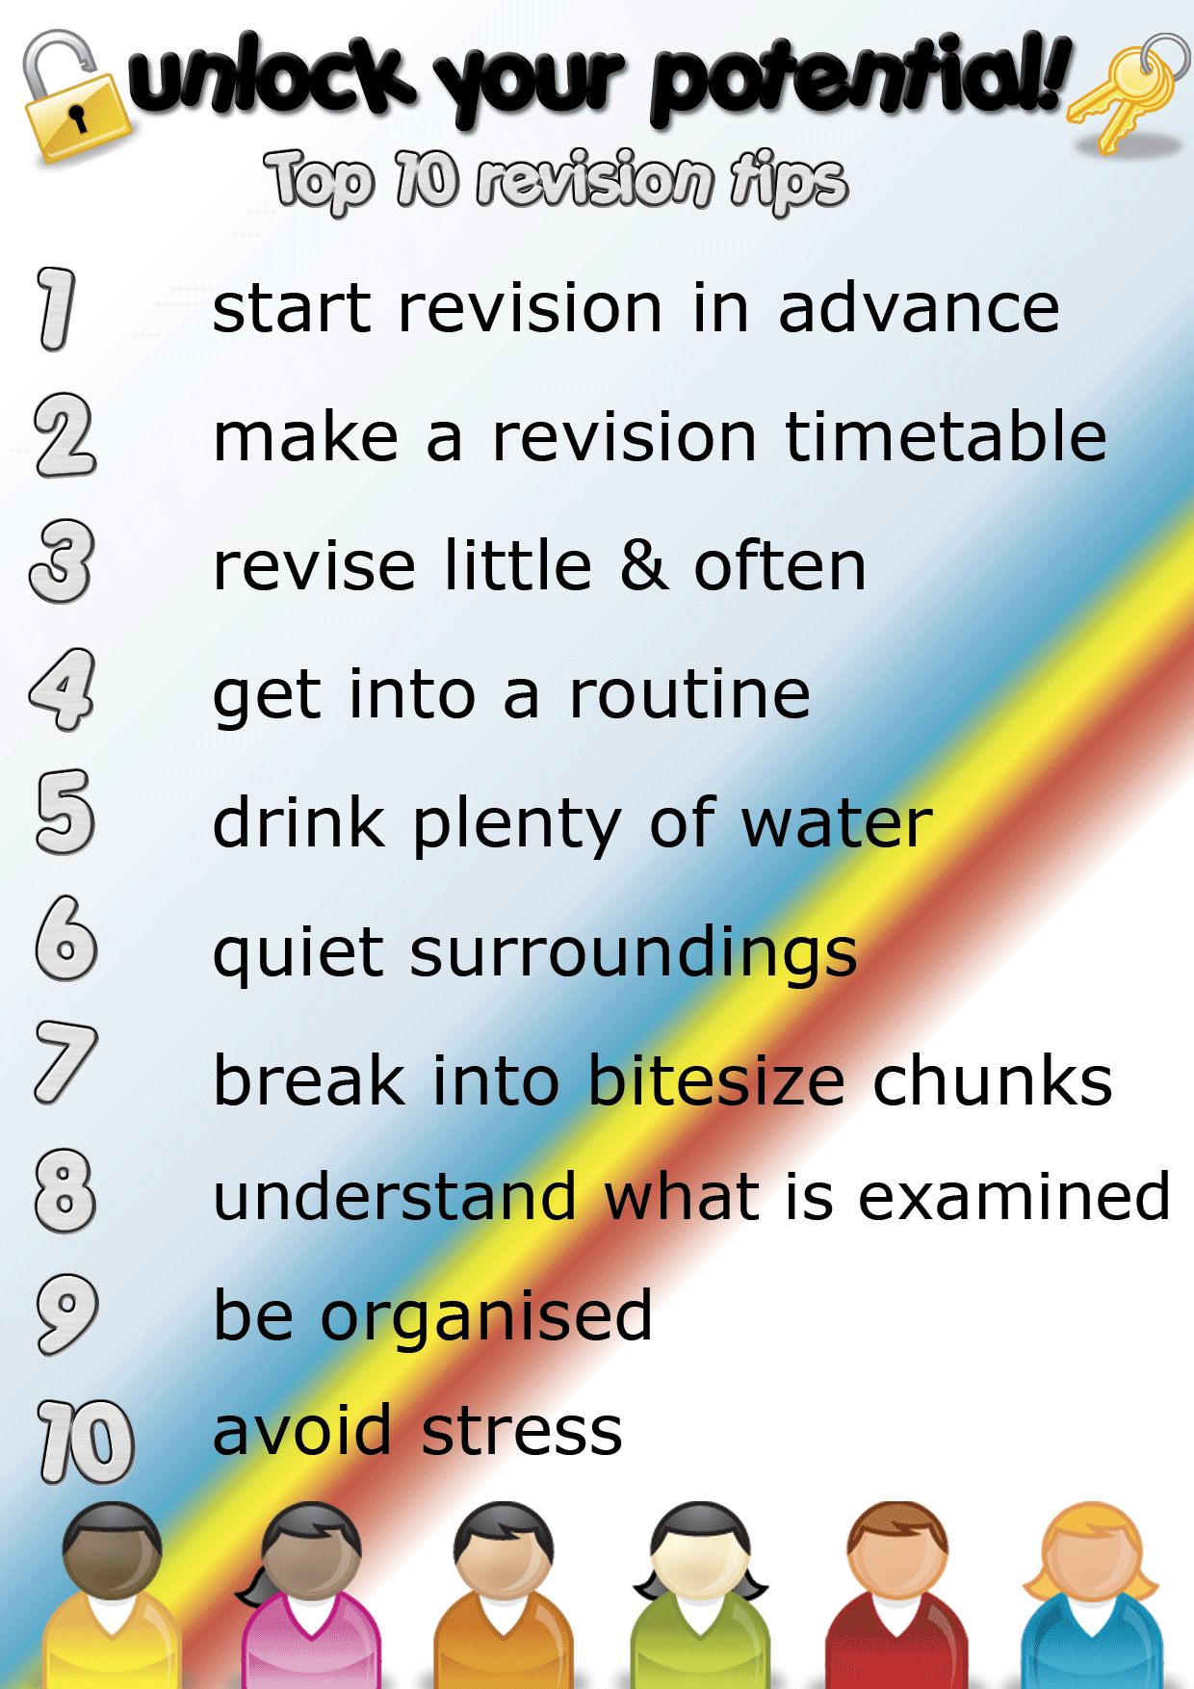
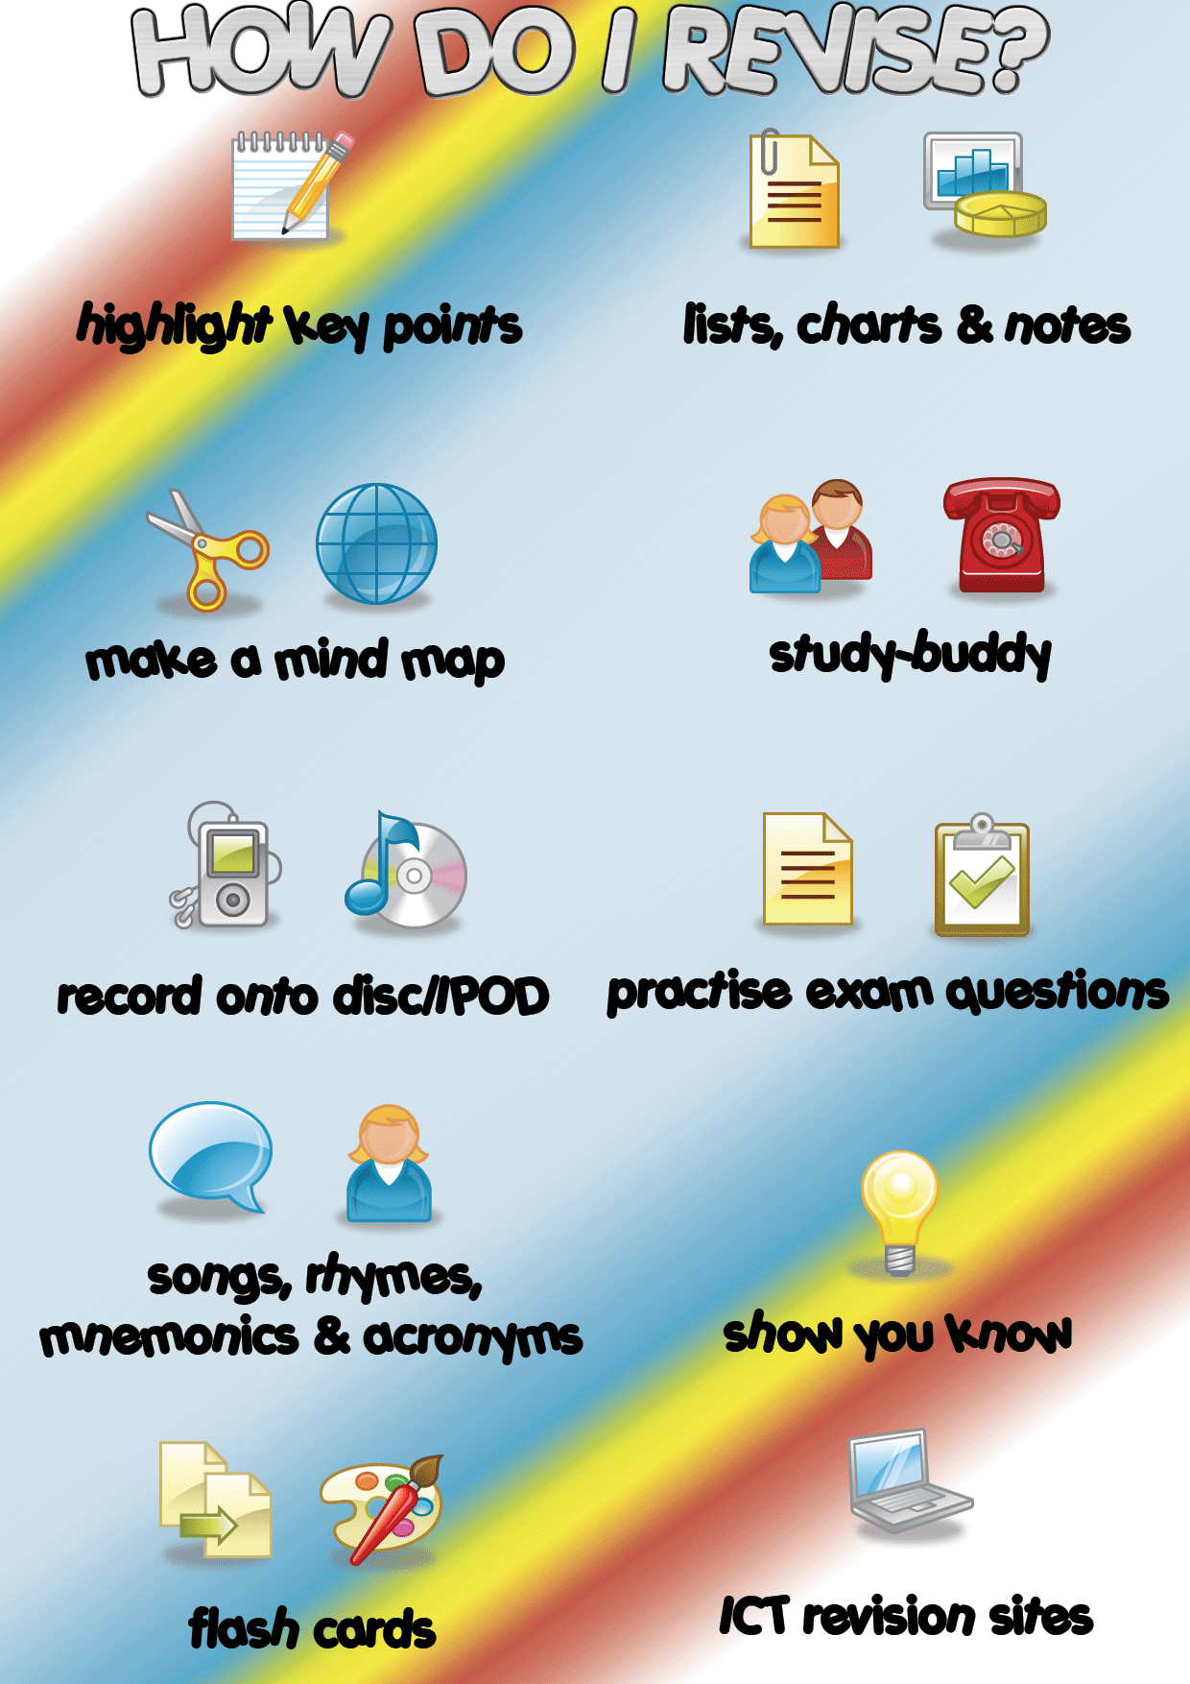
Year 11
Tips

Slide 26
Good Luck

